Slide 1
CUSTOMER CARE REGISTRY
Customer Journey map

Slide 2
TEAM DETAILS
Team No : PNT2022TMID10775
College Name: IFET College of Engineering
Department : Electronic and communication Engineering
TEAM MEMBERS
RAHUL M
SELVENDIRRAN P
RAHUL KRISHNA J
SATHISH KUMAR S
SATHEESH KUMAR SR

Slide 3
PROJECT DESIGN PHASE - 2
Customer journey map
DATE | 12 November 2022
TEAM ID | PNT2022TMID10775
PROJECT NAME | CUSTOMER CARE REGISTRY
MAXIMUM MARKS | 2 Marks

Slide 4
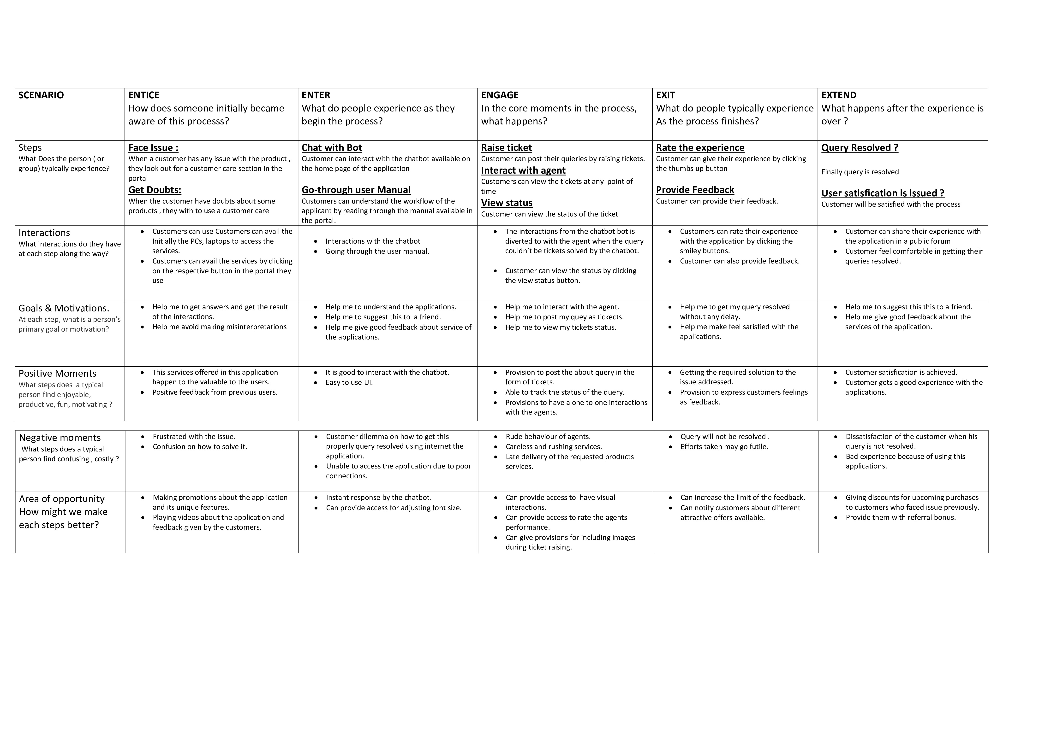

Slide 5
THANK
YOU

